Slide 1
Marketing
Environment

Slide 2
(PEST) ANALYSIS Political Legal-Rules, Laws, Companies Act, Consumer protection Act, Environmental protection Act etc. ASCI, FSSAI,TRAI, IRDA, SEBI. Economic-Purchasing power, Inflation, Recession, Income. Socio-cultural, Spiritual-Values, Attitude, Norms, Lifestyle. Technological-Research, Innovation. Natural-Environment, Pollution, Global warming, Demographic- Population Growth, Mix, Literacy, Location, Census. Internal-Company- R&D, Production, HR, Location, Financial Capability. External-MICRO ( Suppliers, Customers, Intermediaries, Competitors, Public)& MACRO (PEST-ND)

Slide 3
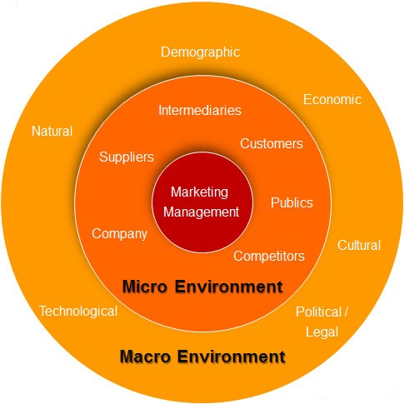
Marketing Environment

Slide 4
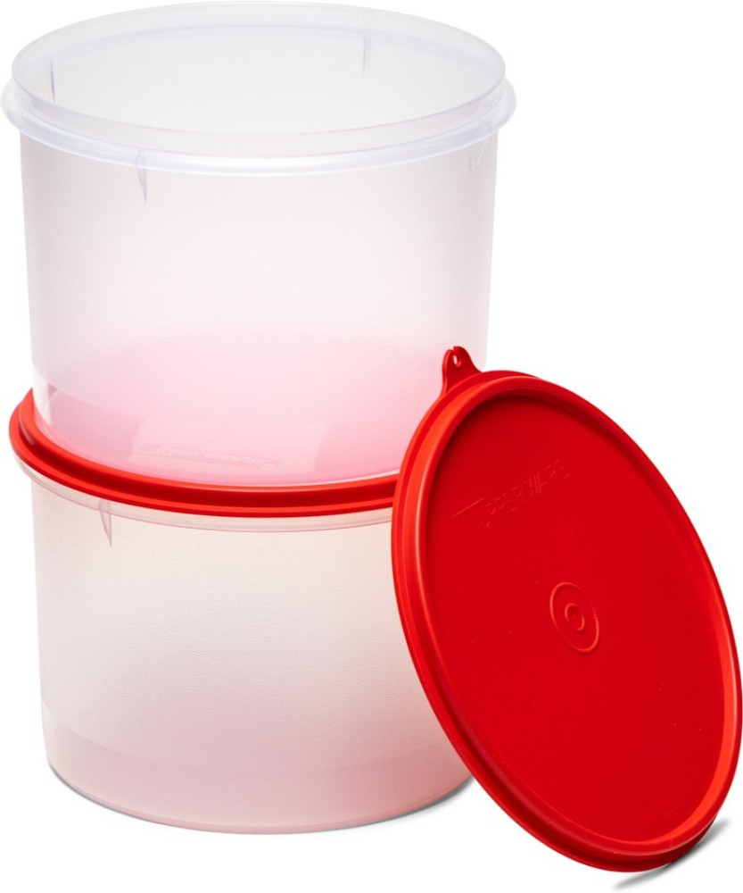

Slide 5
Political-Legal ITC –T for…..
ITC aims to become the number one FMCG company. Government notification - health warning graphics should cover
85% of the packet compared to the requirement of
40% on one side of the pack.
60% per cent of net segment revenue is derived from businesses other than cigarettes. Segment revenue, other than cigarettes, has grown more than 17-fold since 1996

Slide 6
The toilet cleaner segment, which was growing at 3-6%, has seen a sudden 10-12% growth RB- Banega Swachh India campaign –Dettol, Harpic HUL- ‘Clean-India' - Lifebuoy's hand-washing programme, Domex Dabur - `Swachh Toilet, Swachh Bharat Abhiyan',. Sanifresh toilet cleaners. The WHO and the United Nations Children's Education Fund (UNICEF) estimate that there are more than 620 million people engaged in open defecation due to lack of access to proper sanitation and 60% of all open defecation is in India.
Swachh Bharat Mission

Slide 7
United Nations - June 21 International Yoga Day, GWR conditions. Jawaharlal Nehru stadium - 29,973 people record was set up by students at a Gwalior university in 2005. Rajpath as the new venue because of its vast area and historical significance. One person needs around three square metre area for performing yoga activities. Morarji Desai National Institute of Yoga developed the protocol. The GWR, however, found 105 people not performing Yoga and removed their names from the finally tally of 35,985 people who set the new world record. Snapdeal launched a special yoga-themed store featuring over 500 yoga–related products like yoga learning e-guides, mats, modern yoga equipment, yoga-wear and more. VLCC conducted free yoga sessions. Freecultr has launched trendy ‘Yoga’ themed T-shirts. Art of Living store on eBay offered audio CDs and DVDs. Yatra.com has announced special yoga packages for its customers. The packages to Hrishikesh in North and Kovalam in the South of India.
Yoga

Slide 8
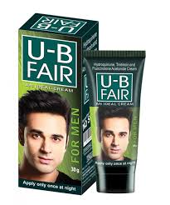
Fairness creams-FDA
Fairness creams are again under scrutiny with the Maharashtra FDA issuing notices to Chandigarh-based pharmaceutical company Torque Pharma over the latter’s attempts to position its steroid-based fairness creams as over-the-counter products.
Steroid-based drugs or creams have to be prescribed by a doctor, which means these cannot be advertised at all. Torque, best known for its Torex cough syrup , has been heavily advertising one such cream, U-B Fair for Men. This caused regulatory action.

Slide 9
Multiplex would be well within its right to disallow a patron to carry water bottle inside the theatre for security reason. Three Agartala residents had moved the forum against Rupasi Multiplex for restraining them from carrying water bottles into the cinema hall while complaining that there was no provision for drinking water inside the multiplex, except the option of buying highly priced water bottles from the cafeteria. "If such a deficiency is shown, the consumer forum would be fully justified in awarding suitable compensation to the complainant," the NCDRC bench said, sending a warning to multiplexes all over the country. In opinion, it constitute unfair trade practice within the meaning of Section 2 (r) of the Consumer Protection Act, 1986," the NCDRC said. Finding Rupasi Multiplex guilty of deficiency in service. The national consumer forum has asked a multiplex to pay a patron Rs 11,000 for refusing to allow to carry a Rs 20 water bottle inside even though it had not made provision for free, clean drinking water inside the cinema hall
Multiplex – NCDRC

Slide 10
Consumer Protection Act
The right to be fully informed about the performance and quality of all goods and services
The right to free choice of goods and services
The right to seek redresal, whenever consumer rights have been infringed
Right to safety- marketing of hazardous goods
etc

Slide 11
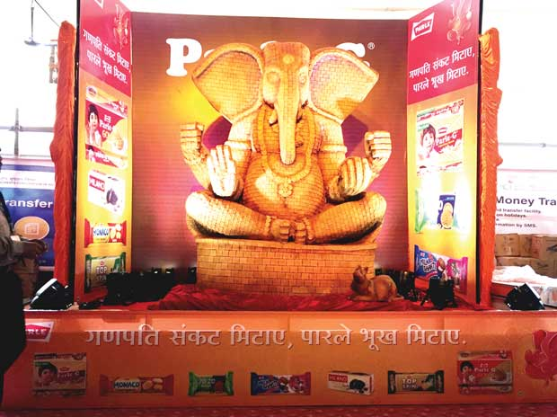
Socio-cultural, Spiritual

Slide 12
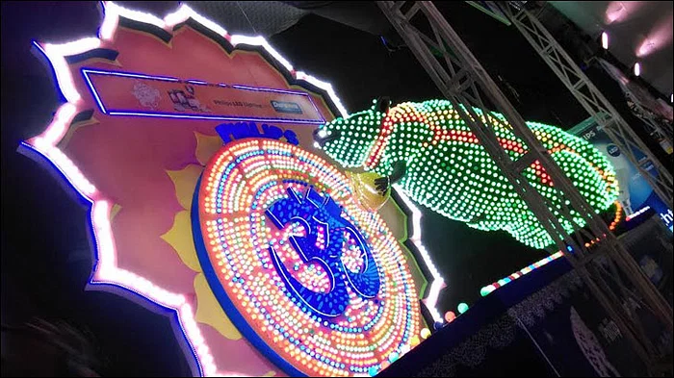

Slide 13
Philips, the electronics brand, has put up a unique innovation made with 6,380 Philips LED bulbs. The grand, techno-artistic structure comprises a thirteen-foot-long Mushak, who is supposed to be Ganesha's carrier, along with a twenty-six-foot long Om, in the colours of brand Philips. Objective is to highlight fact that Philips LED comes with Duramax technology which offers longer lasting brightness. The detailing of the structure has been done to showcase that Philips LED bulbs are available in multiple power outputs, across a variety of colours and various layers of brightness to suit consumers needs. In the installation, different lumen capacities of Philips LED light bulbs have been used, ranging from 0.5 watt to 4 watts. The objective of the installation is to provide an actual 'touch and feel' of Philips LED bulbs. Prior, Philips had created an eye-catching 'modak' made up of Philips LED bulbs at the same venue.

Slide 14
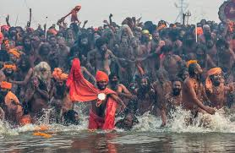
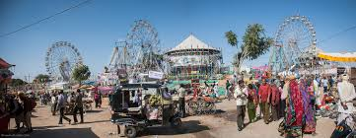
Mela
50,000 villages or the 200 melas
There's a difference between religious melas like the Kumbh that draw 5 crores to 8 crores of people over 30 to 40 days and smaller, festive melas that last for a shorter time frame and typically bring in 10,000 to 20,00 people a day, with a mix of urban and rural audience. The latter are a better bet since they tend to be more marketing friendly, it's the greatest aggregator of an otherwise very diverse and hard to reach audience. Mass media is not a safe bet and rural marketing operations that go from village to village are prohibitively expensive. It's an opportunity to get a sizable number of rural consumers at one go and in a way they come to you with money in their pockets.
While the main focus of a mela is usually religious, once darshan and the snaan is done with, Shopping is the focus The only place where you will see rural folk holding their wife's hand for the fear of being lost or separated. The social sanctions that usually keep women cloistered don't apply as stringently at melas. Many marketers view it as a unique opportunity to reach out to women: influencers who are otherwise hard to connect with.

Slide 15
HUL's 3 Roses At Maha Pushkaram, a huge fair held at Rajamundhary in Andhra Pradesh, HUL's 3 Roses, the largest tea brand in South India, wanted to advertise an improved formulation. Apart from upping the visibility of the brand, HUL distributed special cups across 250 tea stalls. The brand logo and message appeared on the cup when it was filled with hot beverage, something of a novelty for large parts of the rural audience, wanted to convey the message during the moment of truth, which is that of consumption. There was a unanimous “wow“ around the “magic“ effect. Many even wanted to take the cup home with them! Vodafone at the last Maha Kumbh, supplyed branded headphones. Besides having pre-recorded bhajans and commercial messaging, they also doubled up as earmuffs. At the Maha Kumbh, people were camping out and Odomos is the only protection against mosquitos that works both outdoors and indoors. Dabur distributed it extensively in sachets. At the Kumbh Mela in Nashik, Dabur's digestive brand Hajmola is being sampled at all large eateries.

Slide 16
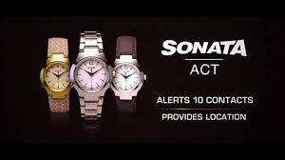
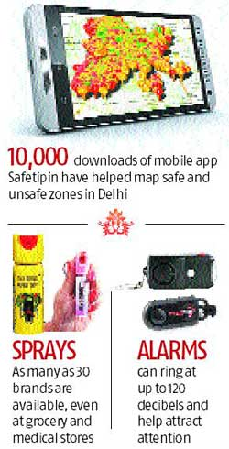


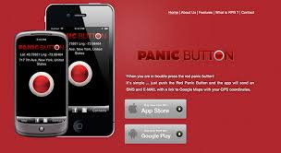
Pepper sprays to stun guns, from keychain alarms to folding credit card knives, the self-defence market is taking baby steps in a largely untapped market.

Slide 17
Young women - job offers in Delhi and its suburbs. Abroad--parents raise no objections- Delhi in her own car- firearm is the only way "I'd feel truly safe in the city". Women in Delhi have over 15 safety apps to choose from. Most of them alert a list of emergency contacts, and transmit the victim's location through GPS. The newer of these don't even require the app to be opened - for instance, just shaking the phone three times activates the emergency contacts. Delhi Police launched a safety app called Himmat, The police have also launched WhatsApp and Hike groups where women can send photos of "undesirable elements". One way out is to learn self-defence. Offices too want their women employees to be prepared. Self Defence, a private fitness company, has conducted close to 250 trainings for companies such as HCL, Ranbaxy, Iris Software, IBM, Indigo Airlines - a 60 per cent increase in the last three to five years. For many working women in the city, cabs have become a necessity - call a friend and stay on the phone the entire duration of the ride, keeping them updated about every turn the cab takes. There are many women who are taking up driving as well - to avoid cabs. Maruti Suzuki - driving schools enrolment increased. Uber claims to have tightened its security features, which includes "re-verification of all driver partners with the police, additional background screening, and the establishment of a dedicated local incident response team to handle critical situations".
Self-defence

Slide 18

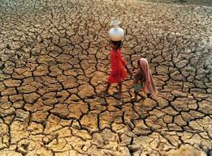
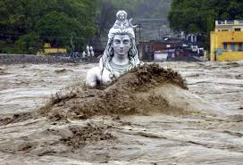
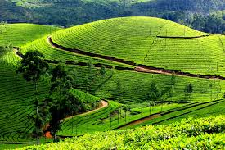
Natural

Slide 19
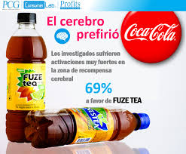
Coca-Cola production-cut
Replan production for the quarter- which had to cut back production cycles running only two/three days a week at least for a limited time.
Apart from a slowdown in spends, unseasonal rain has wreaked havoc on the sector, with the window for sales having shrunk considerably in the past two years.
Cool and rainy weather conditions lasted through April in most of the country, particularly northern markets, including Delhi-NCR, Punjab, Haryana, Uttar Pradesh and Himachal Pradesh, which contribute close to half of national soft drinks sales.
April-June is the peak season for soft drinks industry in the country, contributing about 40% of annual sales estimated at over Rs 14,000 crore.
The launch of Fuze tea not only does it reduce dependence on carbonated soft drinks, it also de-risks from seasonality because consumption of tea isn't restricted to seasons.

Slide 20
-Real Estate
The value of unsold apartments across the top seven cities of the country has been estimated at a whopping Rs 4 lakh crore, with few signs the inventory will be cleared anytime in the next four years. At 7.5 lakh, the number of flats in the mid-priced range is virtually the same, which means sales have come to a standstill. In addition, there are 50,000 luxury apartments, priced at an estimated Rs 1 lakh crore, lying unsold in Mumbai alone. Developers are now reducing the sizes of the apartments to make them more affordable.

Slide 21
The number of employees whose income is below Rs 40,000 a month, gone up. These are the potential customers for the mini and the compact cars. The biggest beneficiary - Maruti Suzuki as the company is the leader in entry level segment with models like Alto, Wagon R, Celerio and Swift. Hyundai -i10 at the entry level and the hatchback segment. The 7th Pay Commission -resulted in almost 25% of the central government and 20% of state government employees becoming eligible car buyers, earning over Rs 40,000 a month. This would make almost 3 million employees a target segment for Maruti.” Customers look to upgrade from two-wheeler to cars at this juncture.
Economic 7th pay

Slide 22
Technological
ChatGPT
AI
5G
Cashless
Smart watches
Driverless cars
Wearable's
Electric cars
Apps
Ecommerce
Social Media

Slide 23
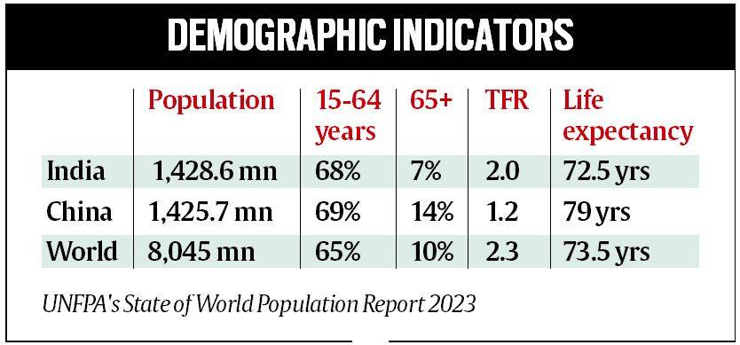
India’s population 142.8 crore in 2023, crosses China’s: UN population report

Slide 24
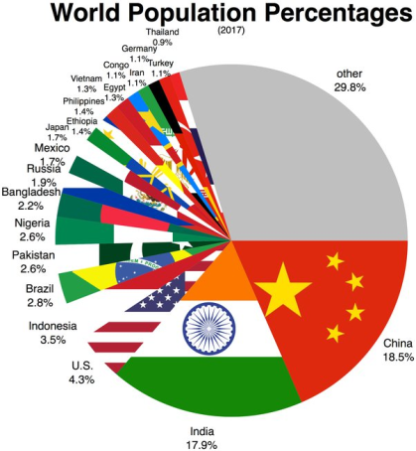
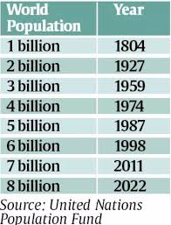
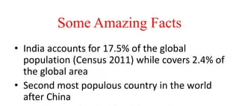
Demographic

Slide 25
Nestle India -production capacity expansion Internal
Rise in Demand
Activities and new launches have helped Nestle India maintain leadership positions in more than 85% of product categories
Brands like Lactogen and Nan (together 67.7 per cent),
Cerelac (96.1 per cent),
KitKat, Munch and Milkybar (together 61 per cent),
Nescafé (51 per cent) and
Maggi noodles (60 per cent) are market leaders in their respective categories.
Focus on consolidating its business activities by adding capacity and strengthening the market position of its newly launched products.
Expanding our capacity - either by adding lines in our existing facilities or through a new plant.
The last time Nestlé set up a plant in India was in 2012, when its facility at Tahliwal, Himachal Pradesh.
Currently, the 107-year-old firm has eight manufacturing facilities in the country.
Its first facility at Moga in Punjab came up in 1961.

Slide 26
Public Bournvita
12 million views -In the video, Himatsingka who presents himself as a nutritionist and a health coach, claimed that Bournvita has sugar, cocoa solids and cancer-causing colourant. Video has created "panic, anxiety. Deleted by the influencer Revant Himatsingka after being served a legal notice by the company.
Mondelez India-owned health drink brand Bournvita -rejected the claims of a social media influencer of having high sugar content, terming a video posted by him as "unscientific", which "distorted facts and made false and negative inferences".
Rejecting it, Bournvita in a statement said over the last seven decades, it has earned the trust of consumers in India by being a scientifically formulated product that adheres to quality standards and complies with the laws of the land.
The formulation has been scientifically crafted by a team of nutritionists and food scientists to offer the best of taste and health. All our claims are verified and transparent and all ingredients have regulatory approvals. All the necessary nutritional information is mentioned on the pack for consumers to make informed choices," said a Bournvita spokesperson.
The company said Bournvita is best consumed with a glass of 200 millilitere of hot or cold milk as highlighted on the pack.
"Every serving of 20 gm of Bournvita has 7.5 grams of added sugar, which is approximately one and a half teaspoons. This is much less than the daily recommended intake limits of sugar for children,"
Moreover, over Caramel Colour (150 C), Bournvita said it "is within permissible limits as per guidelines defined by regulations".
Cadbury Dairy Milk, 5 Star, Oreo cookie and Gems.

Slide 27
Thank You

